Slide 1





Enhancing Urban Traffic Control with AI: A Predictive and Adaptive Management System
Name :PANDEESWARAN M Guide: P. Raja, Master Trainer
NM-ID : au921821114011
E - mail :villurpandeeswaran@gmail.com
Disclaimer: The content is curated for educational purposes only.
Notes:
Slides: Prepare a short slide deck (10-12 slides) summarizing the project objectives, methodology, and key results.

Slide 2
OUTLINE
Abstract of the Project
Problem Statement
Proposed Solution
System Architecture
Live Demo of the Project
Embedded Video of Project
Conclusion
Future Scope

Slide 3
Abstract
This project aims to develop an AI-powered traffic management system designed to monitor, analyze, and control traffic flow efficiently in real-time. By leveraging data from sources such as traffic cameras, sensors, and GPS, the system can predict traffic congestion, detect incidents, and suggest alternative routes to drivers. The project incorporates machine learning models for traffic prediction, anomaly detection, and route optimization, providing a comprehensive solution for urban traffic challenges. The system is also equipped with a user-friendly control center interface for traffic managers and a public-facing mobile app to share live traffic updates and route suggestions. Ultimately, this project demonstrates how AI can be applied to improve road safety, reduce congestion, and enhance travel experiences in urban areas.

Slide 4
Problem Statement
Urban areas face significant challenges related to traffic congestion, accidents, and inefficient road usage, leading to delays, increased fuel consumption, and pollution. Traditional traffic management methods rely heavily on manual monitoring and are often unable to handle real-time demands or provide predictive insights. With the growing population and vehicle count, cities struggle to keep traffic smooth, safe, and manageable. Additionally, sudden incidents or adverse weather conditions often worsen traffic congestion, causing extended delays. Thus, there is an urgent need for an intelligent traffic management system that can predict congestion, detect incidents immediately, and provide effective solutions to optimize traffic flow.

Slide 5
Proposed Solution
The proposed solution is an AI-based traffic management system that combines real-time data collection, machine learning, and predictive analytics to address urban traffic challenges. Using data from traffic cameras, sensors, and AI modules devices, the system can monitor traffic patterns and detect incidents. The AI models developed in this system predict congestion, detect anomalies, and suggest alternate routes in response to changing traffic conditions. An intuitive control center interface allows traffic authorities to receive alerts, monitor real-time data, and adjust traffic signals dynamically.

Slide 6
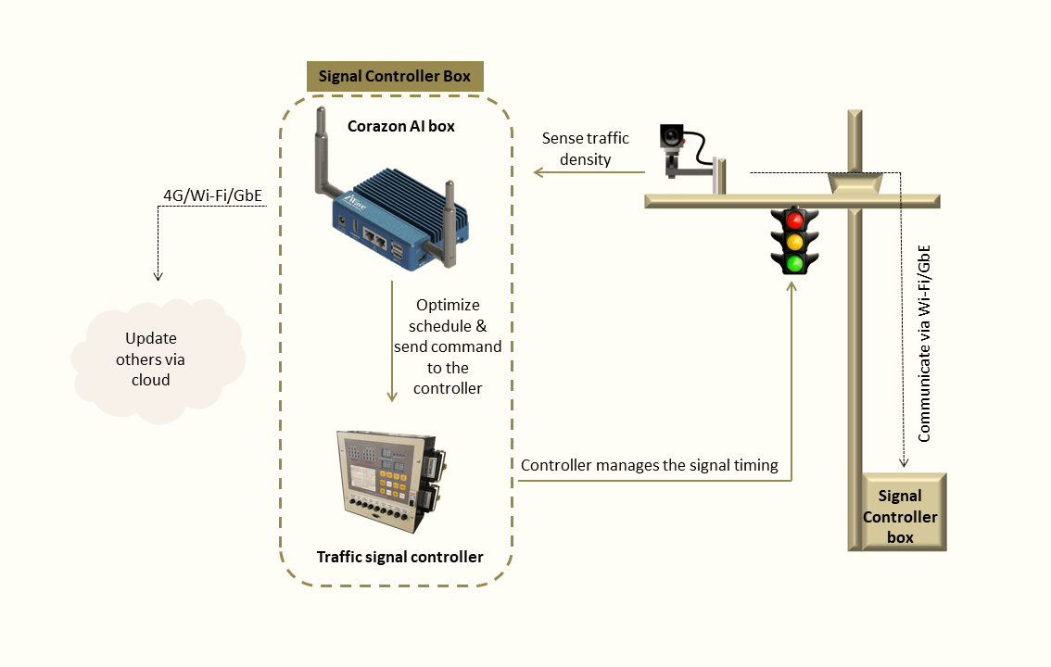
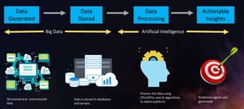
System Architecture

Slide 7
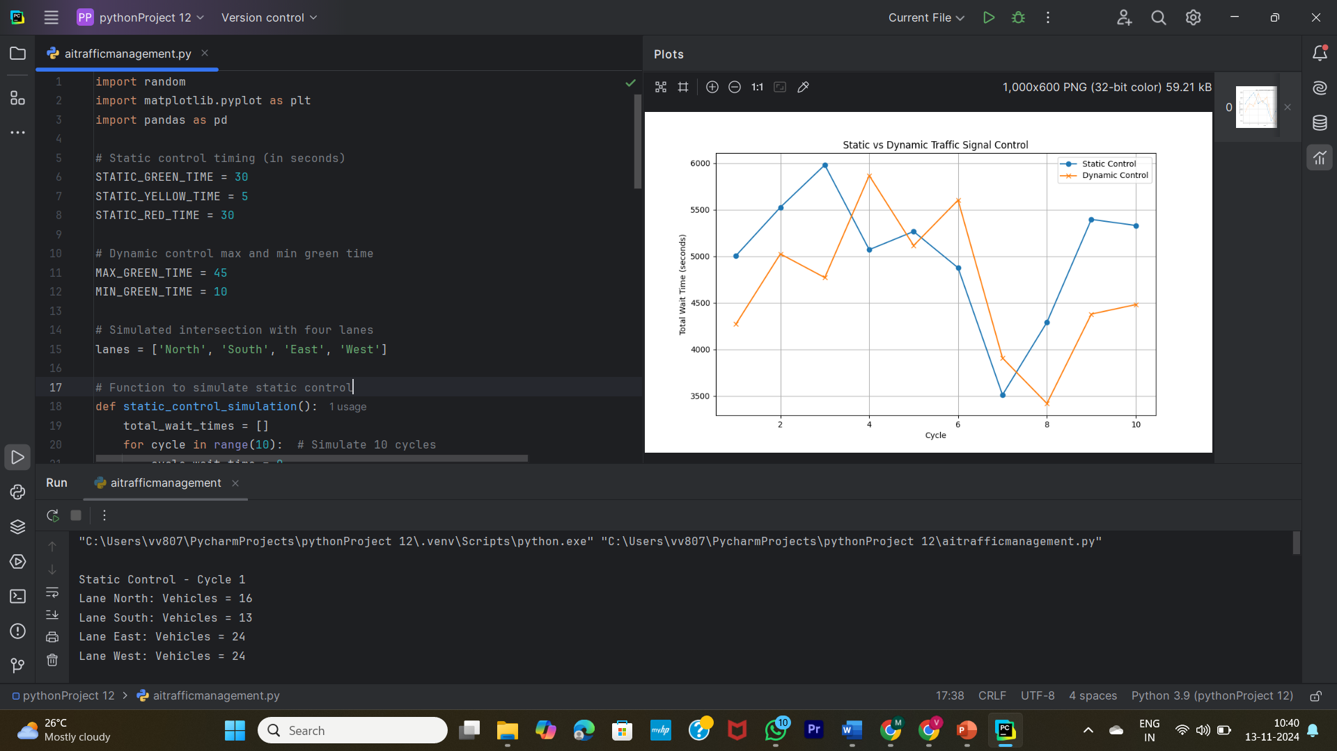

Slide 8
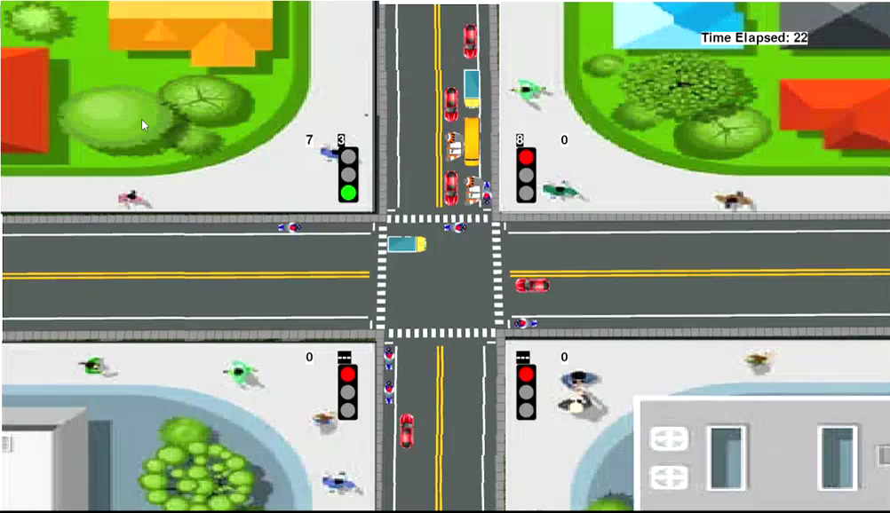
Video of Project Demo Static flow(traditional flow)

Slide 9
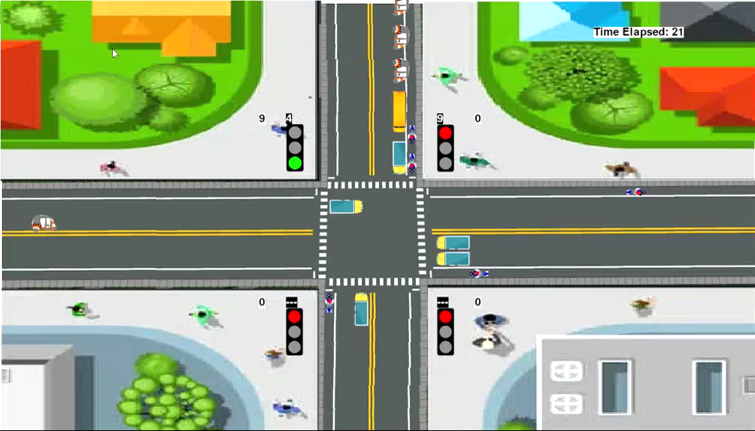
Video of Project Demo Dynamic (Modified Control flow)

Slide 10
Conclusion
This AI-based traffic management project demonstrates a scalable and efficient solution for addressing urban traffic issues.
By integrating real-time data collection, machine learning, and predictive analytics, the system provides actionable insights and alerts that help traffic authorities manage congestion and respond to incidents effectively.
The project illustrates the potential for AI to significantly improve urban mobility, reduce delays, and promote safer road usage. The deployment of this system could help cities optimize their traffic management processes, ultimately leading to reduced fuel consumption, lower emissions, and enhanced quality of life for citizens.

Slide 11
Future Scope
Future enhancements to this AI-based traffic management system could focus on expanding data sources, improving predictive accuracy, and integrating new features. Adding more sensors and exploring satellite-based data could enhance traffic predictions and incident detection.
Advanced machine learning models, including deep reinforcement learning, could provide more accurate and dynamic route suggestions. Additionally, expanding the system to include predictive maintenance for road infrastructure, weather-based traffic predictions, and integration with autonomous vehicles could further optimize traffic management. Partnerships with local governments and urban planners could also enable large-scale deployments in smart city initiatives, expanding the system’s impact on urban traffic flow and safety.

Slide 12
Thank you!
Notes:
thank you very much for joining this PPT, keep learning.
12

